Slide 1


Hand Anatomy
PT4050 / PT7001
Paul Starrs
P.Starrs@londonmet.ac.uk

Slide 2
LEARNING OUTCOMES
Identify bones of the hand and give an account of their joints
Briefly describe the fibrous and synovial sheaths of the fingers
Describe the arrangement of fascia in the hand and name the spaces between fascial planes
Describe the muscles contained within the thenar and hypothenar eminences, and know their innervations and functions
Know the attachments, innervations and actions of the lumbricals and interossei muscles
Briefly describe the dorsal digital expansion
Describe the arrangement of the arteries, veins and nerves of the hand

Slide 3

CONTENTS
Discuss hand anatomy including joint structures, ligaments, muscles and innervation

Slide 4
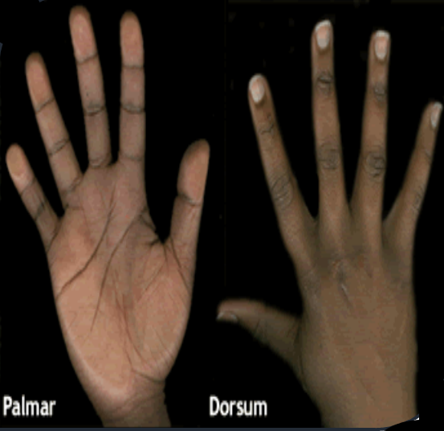
FUNDAMENTALS OF HAND ANATOMY
Hand anatomy is easiest to learn by logically progressing through the material
  Bones → joints → movements at joints → bony landmarks → origin/insertion/action of muscles → neurovascular supply
Similar to the foot, which has a dorsal and plantar aspect, the hand has a dorsal and palmar aspect

Slide 5
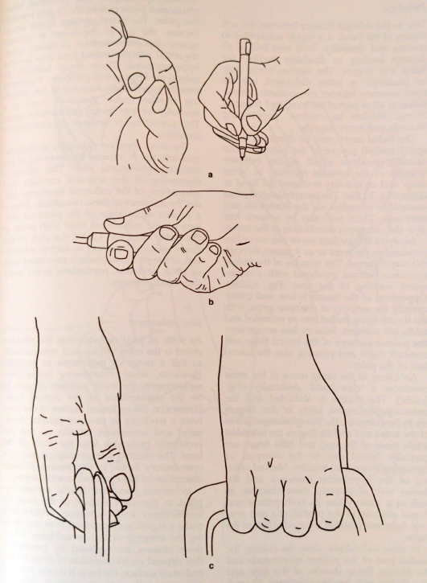

HAND FUNCTION
Exceptionally refined complex needed for grip and manipulation e.g. dressing, playing instruments, writing, typing, etc.
Balance of power and precision required, also, e.g. weight lifting, rock climbing, etc.

Slide 6
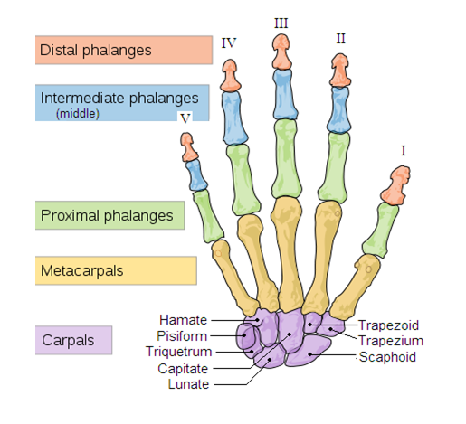
BONES
Twenty-seven bones in total:
  Eight CARPALS
  Five METACARPALS
  Five PROXIMAL PHALANGES
  Four INTERMEDIATE PHALANGES
  Five DISTAL PHALANGES
By convention, the digits are named;
  Thumb (pollicis) (I)
  Index finger (indicis) (II)
  Middle finger (III)
  Ring finger (IV)
  Little finger (minimi) (V)

Slide 7
CARPALS
Some
Lovers
Try
Positions
That
They
Cannot
Handle
Scaphoid
Lunate
Triquetrum
Pisiform
Trapezium
Trapezoid
Capitate
Hamate
Notes:
Common injuries:
- Scaphoid # and avascular necrosis
- Anatomical snuffbox
- Scapho-lunate dislocations

Slide 8
METACARPALS
Long bones that have a:
  Base (A)
  Body/shaft (B)
  Head (C)
The base of each metacarpal has its own unique shape so it can articulate with the bone(s) in the distal row of carpals
The heads are smooth and outwardly rounded (convex) so it can articulate with the proximal phalanx (concave)
C
B
A

Slide 9
PHALANGES
Long bones that have a:
  Larger proximal base (X)
  Body/shaft (Y)
  Smaller distal head (Z)
Proximal base is concave
Head is convex
Z
Y
X

Slide 10
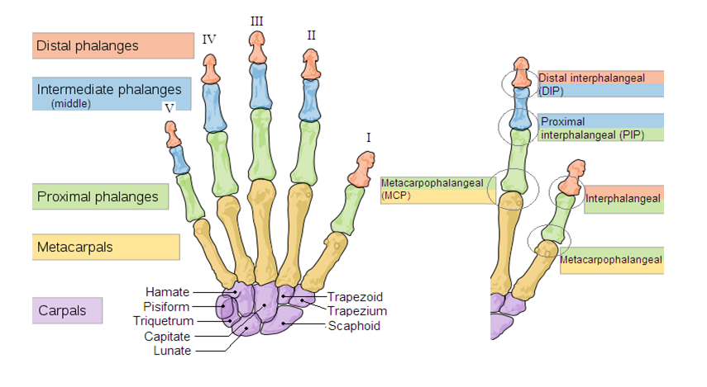
BONES AND JOINTS
Carpometacarpal (CMC)

Slide 11
BONES AND JOINTS
NINETEEN JOINTS!
  x five CARPOMETACARPAL (CMC) joints – the joint between the carpals and metacarpals
  x five METACARPOPHALANGEAL (MCP) joints – the joint at the base of the finger
  x four PROXIMAL INTERPHALANGEAL (PIP) joints – the joint in the middle of the finger
  x four DISTAL INTERPHALANGEAL (DIP) joints – the joint closest to the fingertip
  x one INTERPHALANGEAL joint – the joint in the middle of the thumb

Slide 12
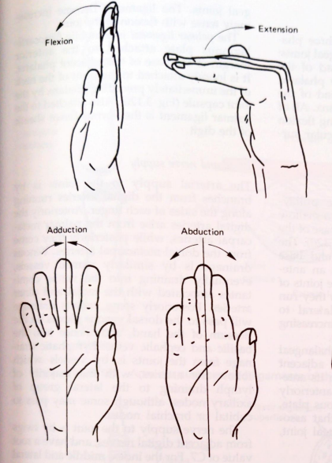
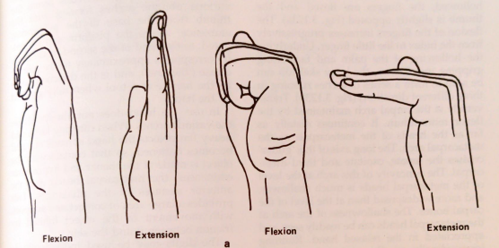
JOINT MOVEMENTS OF THE FINGERS
CARPOMETACARPAL (CMC) joints produce little movement
METACARPOPHALANGEAL (MCP) joints produce;
  Flexion
  Extension
  Abduction
  Adduction
PROXIMAL INTERPHALANGEAL (PIP) joints and DISTAL INTERPHALANGEAL (DIP) joints produce;
  Flexion
  Extension

Slide 13
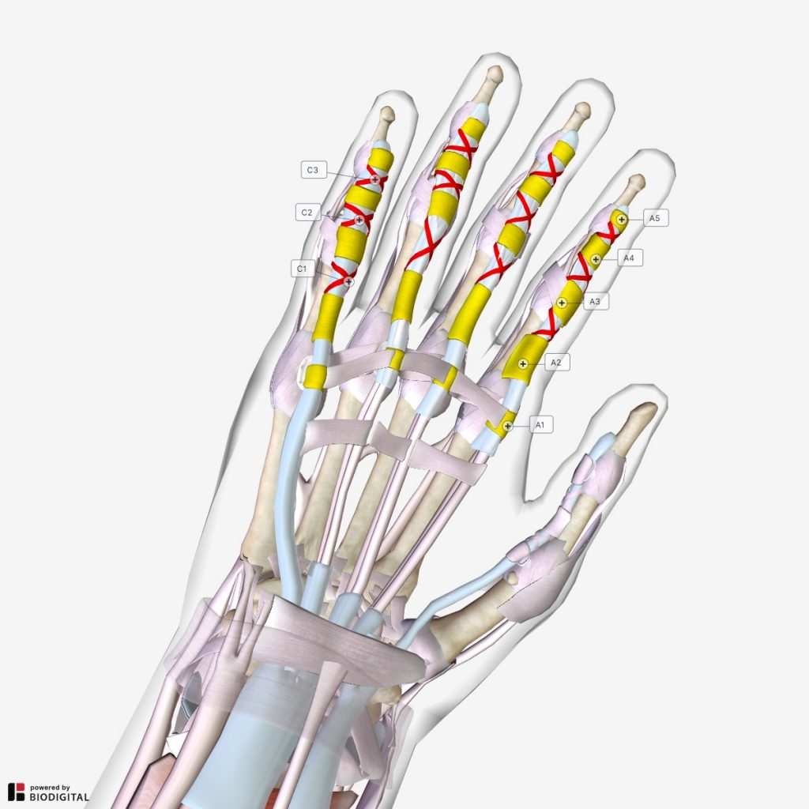
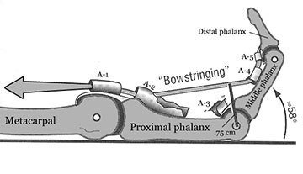
PULLEY SYSTEM OF THE FINGERS
The fingers possesses a complex pulley system to co-ordinate flexion of the digits consisting of:
  Long flexor tendon
  Annular pulleys
  Cruciate pulleys
This system ensures the flexor tendons remain close to the joints axis of motion and prevent ‘bowstringing’
A synovial sheath ensures:
  Smooth gliding of the tendons
  Synovial fluid
  Mechanical advantage

Slide 14
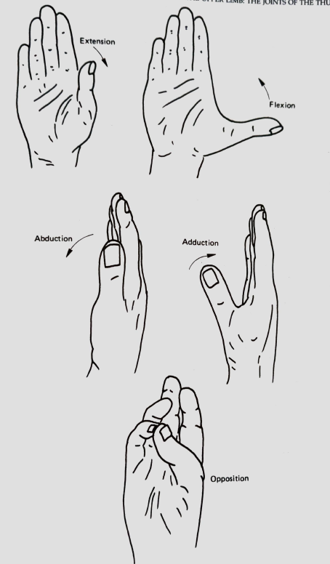
JOINT MOVEMENTS OF THE THUMB
In the anatomical position, the thumb is rotated 90° medially to the rest of the digits, consequently, movements of the thumb are defined at medially orientated right angles to the movements of the other digits of the hand
CARPOMETACARPAL (CMC) joint produces;
  Flexion
  Extension
  Abduction
  Adduction
  Opposition
METACARPOPHALANGEAL (MCP) and the INTERPHALANGEAL joint produce;
  Flexion
  Extension

Slide 15
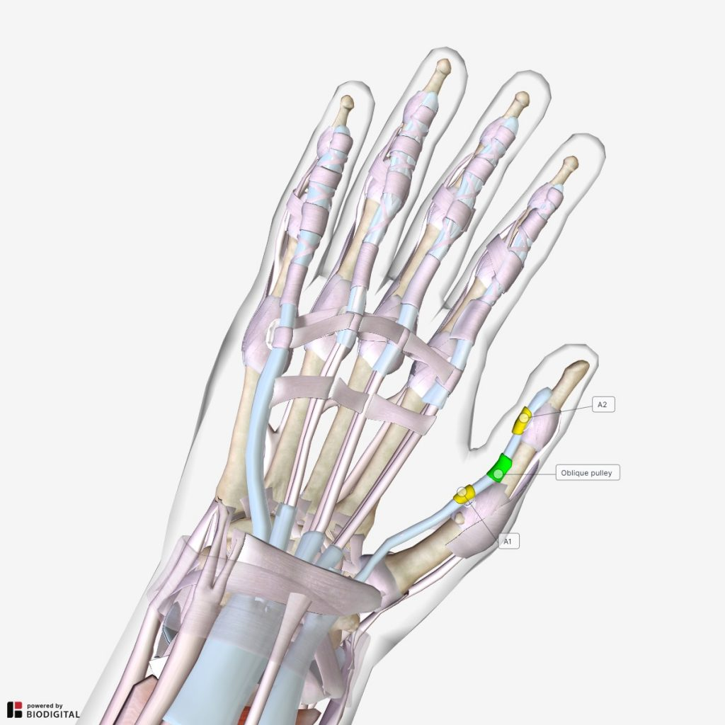
PULLEY SYSTEM OF THE THUMB
The thumb possesses a pulley system too consisting of:
  Long flexor tendon
  Annual pulleys
  Oblique pulley

Slide 16
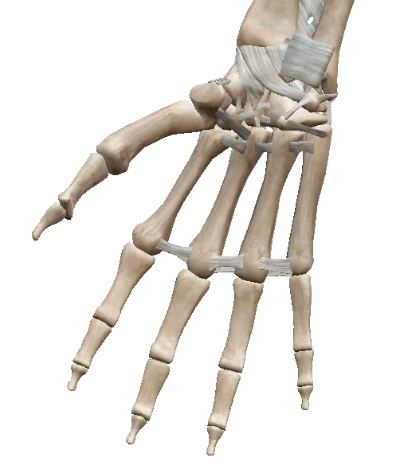
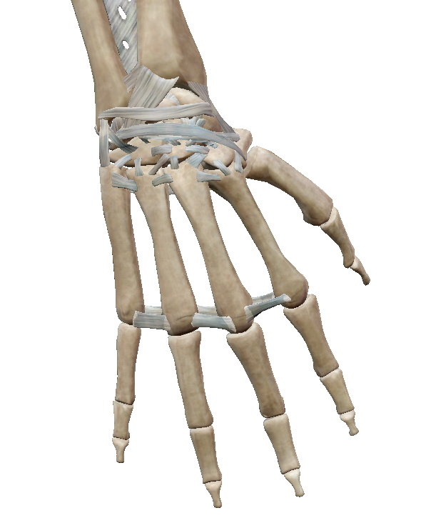
LIGAMENTS
Large number of intercarpal ligaments!
Both superficial and deep intermetacarpal ligaments on the palmar and dorsal aspect
Collateral ligaments on between the phalanges
Volar plate ligaments span the PIP on the palmar aspect of the hand to prevent excessive extension

Slide 17
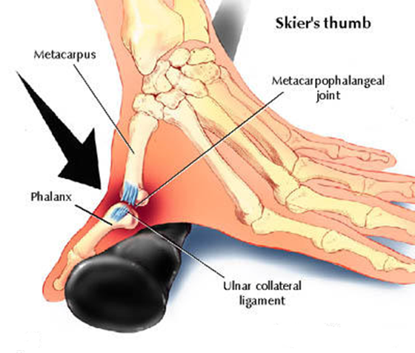
SKIER’S THUMB

Slide 18
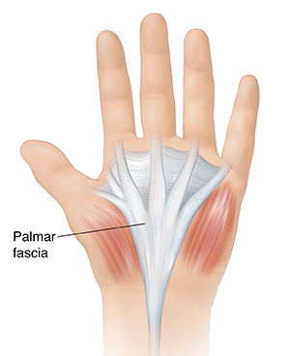
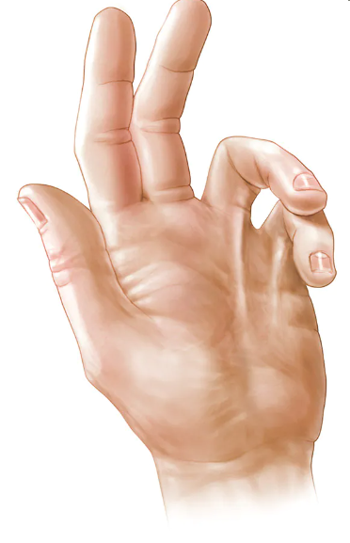
PALMAR FASCIA
The palmar fascia is a triangular-shaped fascial structure with its apex pointed proximally and the base of the triangle at the metacarpophalangeal joints
It is composed of four longitudinal bands overlying each digit
It is liable to undergo contraction, producing an inconvenient hereditary deformity known as ‘Dupuytren’s contraction’. The ring and little fingers are most frequently implicated, but the others may also be involved. The proximal phalanx is flexed and cannot be straightened, and the middle and distal phalanges become similarly flexed as the condition advances

Slide 19
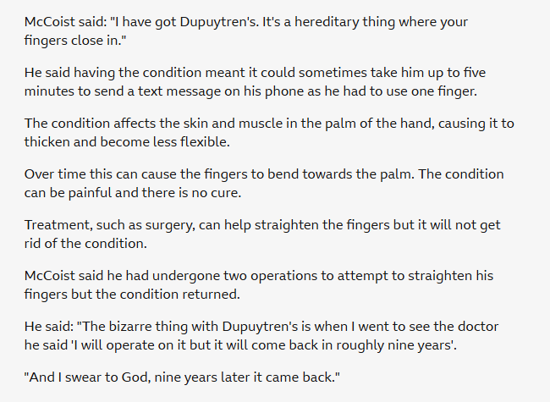

DUPUYTREN’S CONTRACTION

Slide 20
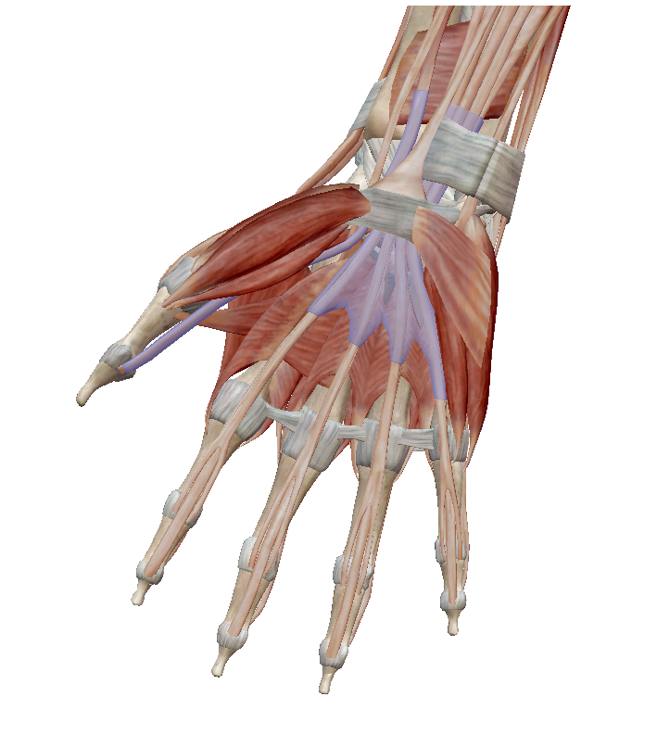
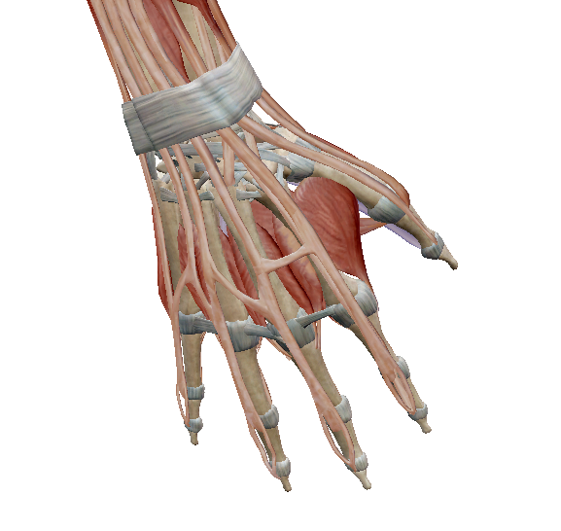
MUSCLES
Notes:
Can be divided up into intrinsic and extrinsic muscles

Slide 21
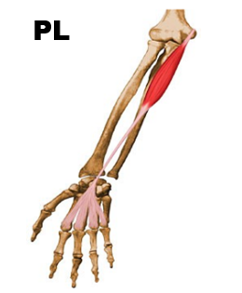
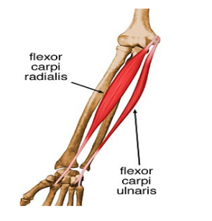
MUSCLES
FLEXORS OF THE WRIST
Flexors originate from the medial epicondyle of the humerus
  Flexor carpi radialis
  Flexors carpi ulnaris
  Palmaris longus

Slide 22
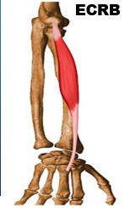
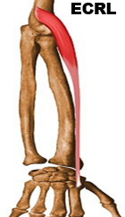
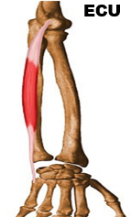
MUSCLES
EXTENSORS OF THE WRIST
Extensors originate from the lateral epicondyle of the humerus
  Extensor carpi radialis longus
  Extensor carpi radialis brevis
  Extensor carpi ulnaris

Slide 23
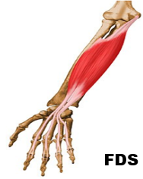
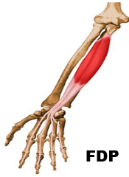
MUSCLES
EXTRINSICS OF THE FINGERS
Flexor digitorum superficialis
Flexor digitorum profundus (Latin for deep)

Slide 24
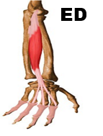
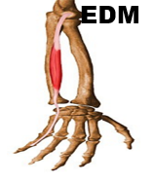
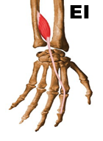
MUSCLES
EXTRINSICS OF THE FINGERS
Extensor digitorum
Extensor digiti minimi
Extensor indicis
Dorsal digital expansion, sometimes referred to as the ‘extensor hood’, holds the extensor tendons in place beyond the PROXIMAL INTERPHALANGEAL (PIP)
DORSAL DIGITAL EXPANSION

Slide 25
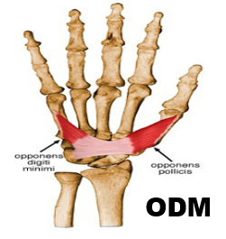
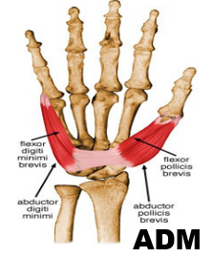
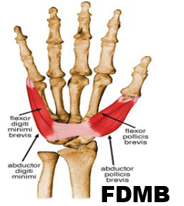
MUSCLES
INTRINSICS OF THE FINGERS
Opponens digiti minimi
Abductor digiti minimi
Flexor digiti minimi brevis

Slide 26
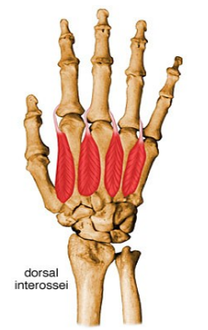
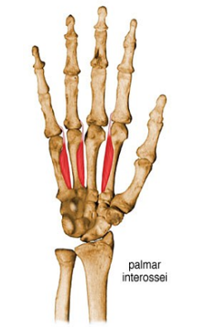
MUSCLES
INTRINSICS OF THE FINGERS
Dorsal interosseii
Palmar interoesseii
Lumbricals

Slide 27
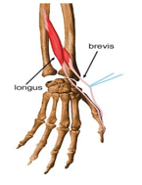
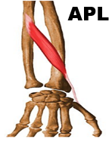
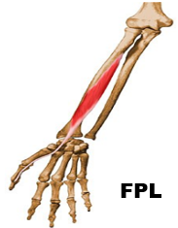
MUSCLES
EXTRINSICS OF THE THUMB
Extensor pollicis longus
Extensor pollicis brevis
Abductor pollicis longus
Flexor pollicis longus

Slide 28
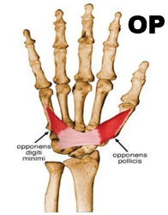
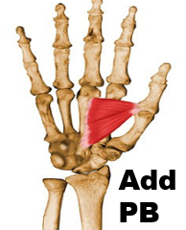
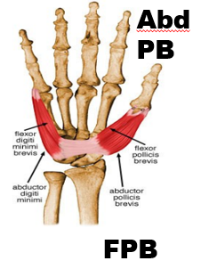
MUSCLES
INTRINSICS OF THE THUMB
Opponens pollicis
Adductor pollicis brevis
Abductor pollicis brevis
Flexor pollicis brevis

Slide 29

ANY QUESTIONS?

Slide 30
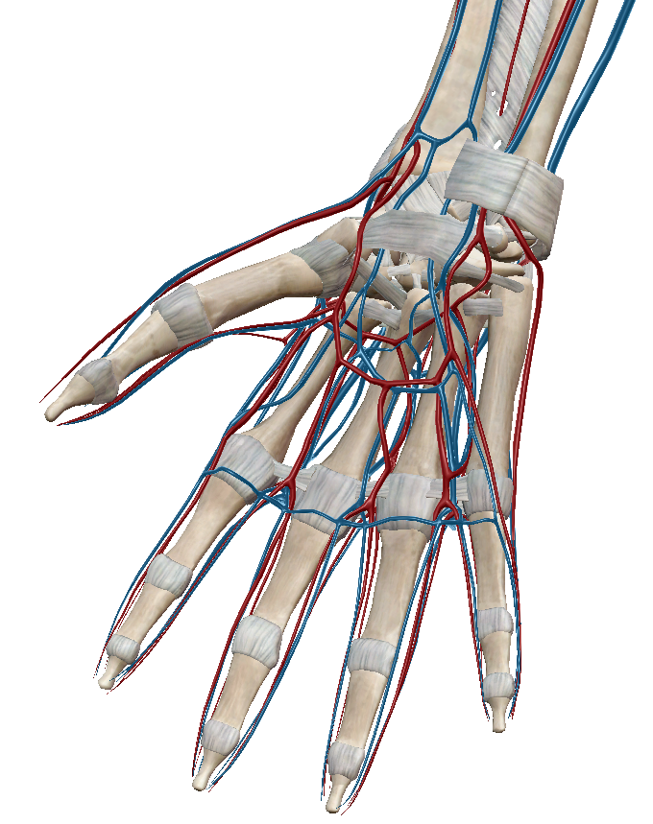
VASULAR SUPPLY
The arteries and veins of the hand arise from the Radial and Ulnar arteries/veins and divide into the Palmar and Dorsal digital arteries/veins

Slide 31
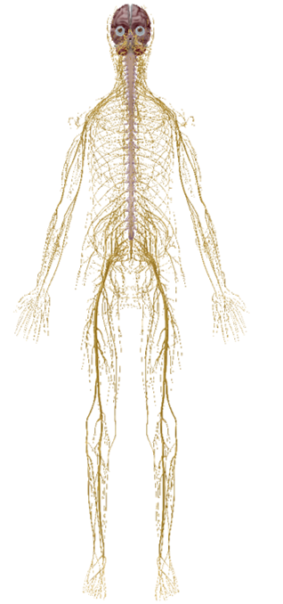
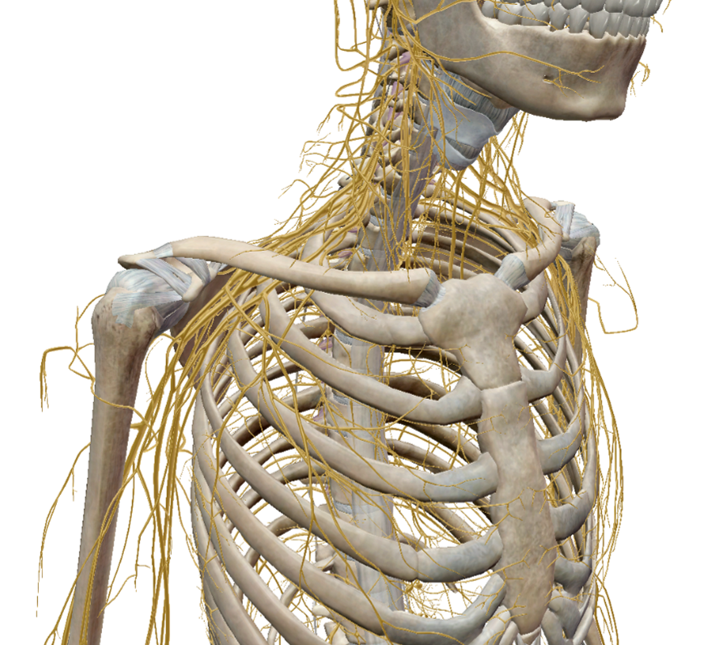
NERVE ANATOMY

Slide 32
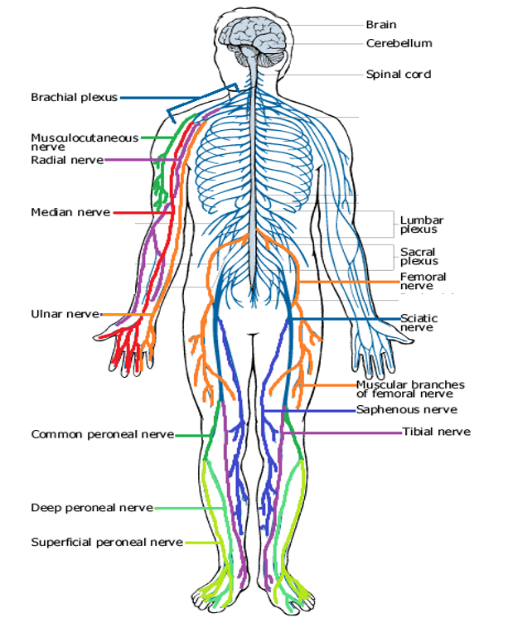
NEURAL PATHWAYS
You need to be aware of all peripheral nerves inc. ones not shown here!
It is important you know their pathway, as well as their dermatological and muscular innervation
‘To test and to treat’

Slide 33
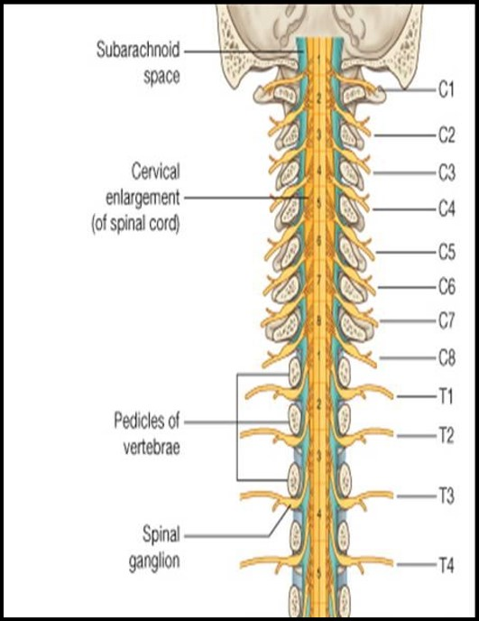
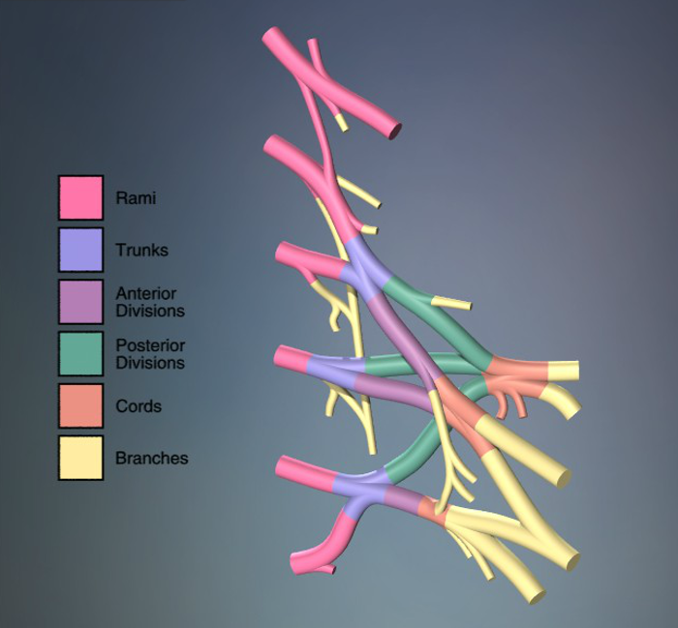
NERVE ROOTS

Slide 34
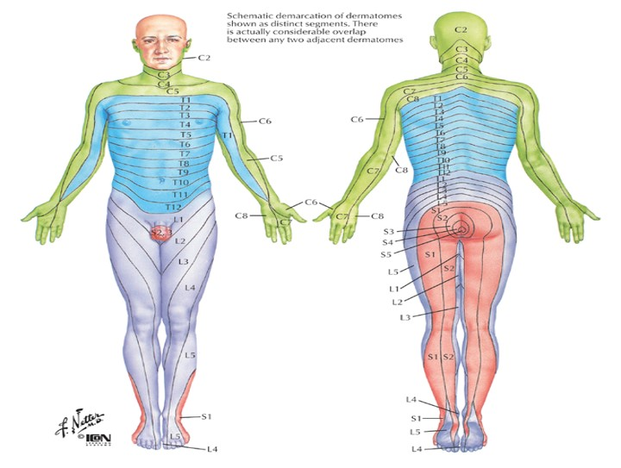
DERMATOMAL MAP

Slide 35
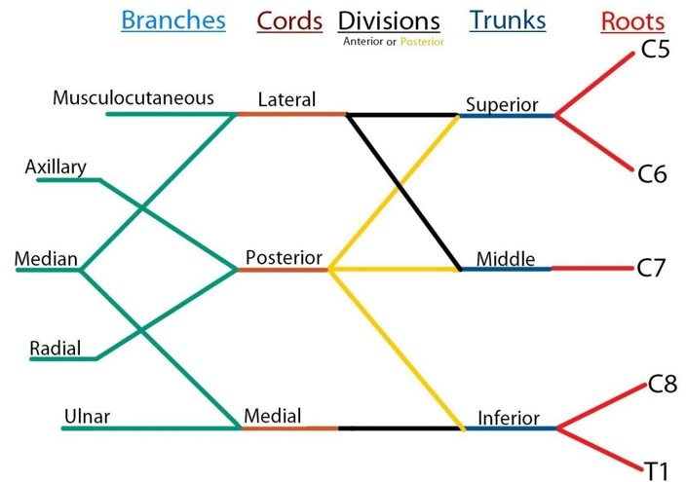
BRACHIAL PLEXUS

Slide 36
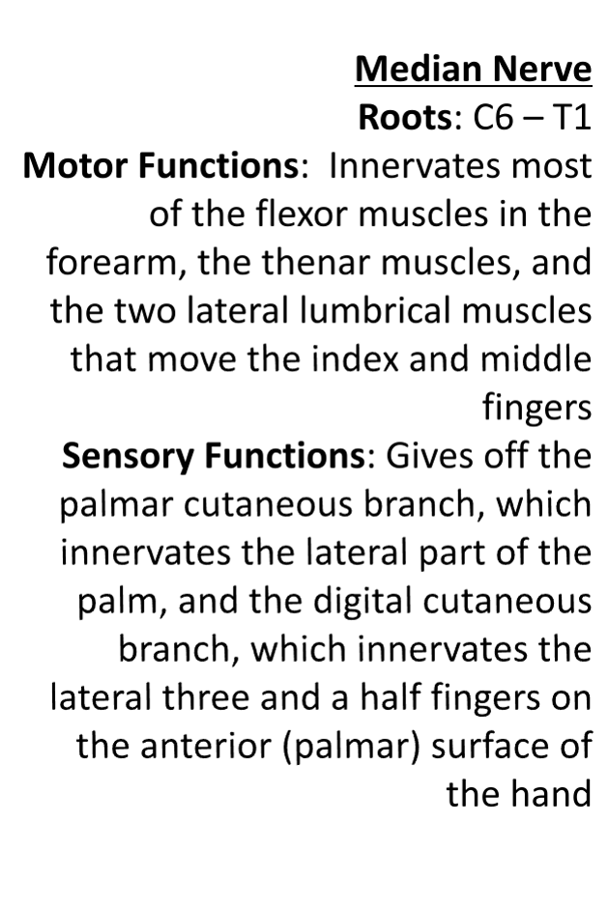
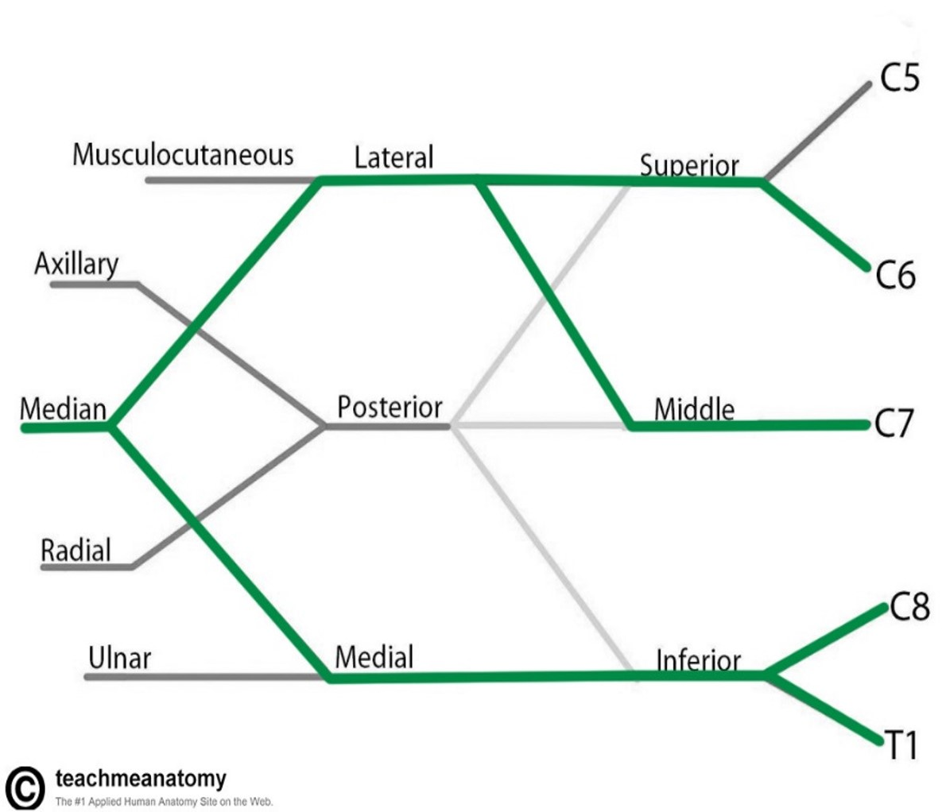
BRACHIAL PLEXUS
MEDIAN NERVE
Notes:
Implicated when pt has carpal tunnel syndrome

Slide 37
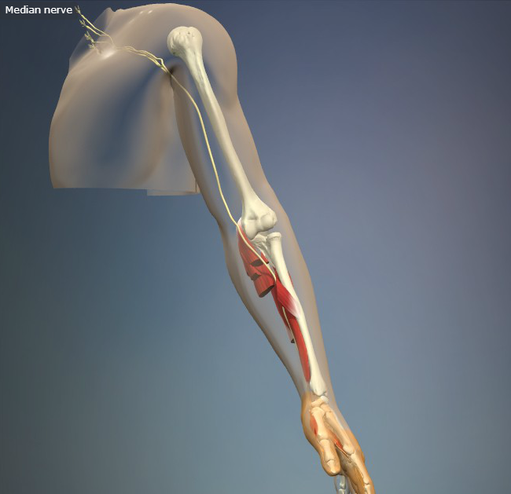

BRACHIAL PLEXUS
MEDIAN NERVE

Slide 38


BRACHIAL PLEXUS
ULNAR NERVE
Notes:
Sometimes implicated when pt cycles

Slide 39


BRACHIAL PLEXUS
ULNAR NERVE

Slide 40


BRACHIAL PLEXUS
RADIAL NERVE

Slide 41


BRACHIAL PLEXUS
RADIAL NERVE

Slide 42
SUMMARY
Hand anatomy is complicated and understanding it is heavily dependent on anatomical knowledge!
Easiest to learn by logically progressing through the material
It is important you know the neural pathways as well as their muscular and dermatological innervation – ‘To test and to treat’

Slide 43
ANY QUESTIONS?

